Slide 1
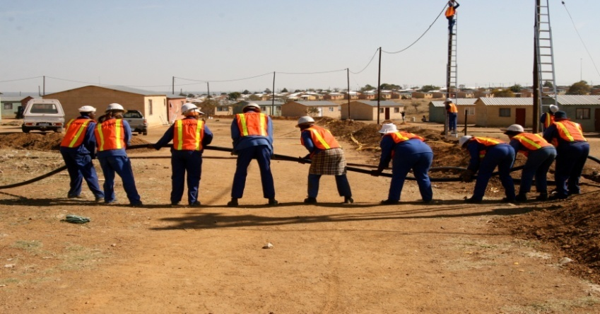
Resolutions of the 4th Expanded Public Works Programme Summit 27 – 28 November 2014 St. Georges Hotel, Irene Mr Stanley Henderson DDG: EPWP

Slide 2
Resolution 1
The Summit notes progress made in signing of protocols for EPWP phase 3.
The Summit resolves that all protocols should be signed by the 30th June 2015.
Progress on implementation of protocols agreements should be monitored and sent to municipal councils on a quarterly basis.

Slide 3
Resolution 2
The Summit notes progress made on development of EPWP municipal policies.
The Summit resolves that all EPWP municipal policies should be endorsed by 30th June 2015.
The National Department of Public Works will provide technical support to Municipalities in this regard.

Slide 4
Resolution 3
The Summit notes the progress made in appointing dedicated officials by municipalities at appropriate level of seniority for EPWP.
The Summit resolves that all spheres of government should ensure that there is dedicated capacity to coordinate and implement EPWP.

Slide 5
Resolution 4
The Summit notes progress made in the establishment of District Forums.
The Summit resolves that EPWP district forums or similar structures should meet on a regular basis, at least quarterly.

Slide 6
Resolution 5
The Summit notes the efforts made by municipalities in ensuring proper record management on their EPWP projects to comply with audit requirements of the Auditor General’s Office.
The Summit resolves that all public bodies should continue to ensure that there is proper record management for EPWP projects.
The National Department of Public Works undertakes to develop an appropriate Management Information System for EPWP phase 3 by 30th June 2015.

Slide 7
Resolution 6
The Summit resolves that municipalities should continue to prioritise EPWP in their Integrated Development Plans.

Slide 8
Resolution 7
The Summit resolves that the principles of EPWP phase 3 should be applied during the implementation of EPWP projects.
The concept of Sustainable Livelihoods should be promoted.

Slide 9
Resolution 8
The Summit resolves that the National Department of Public Works and all lead sector departments should continue to liaise with relevant stakeholders to source funding for training and ensure that quality training is provided to EPWP beneficiaries.
Lead sector departments should encourage Public bodies to set aside part of their budgets to fund training of participants on their projects.

Slide 10
Resolution 9
The Summit resolves that the National Department of Public Works and all lead sector departments should continue to provide technical support to all spheres of government to promote the implementation of the EPWP in the use of labour-intensive methods, promotion of community involvement, sustainable livelihoods, and convergence.

Slide 11
Resolution 10
The Summit resolves that the National Department of Public Works will continue to strengthen the coordination between municipalities, NPOs and implementing agents so as to promote the implementation of the Non-State Sector.

Slide 12
Thank You

